Slide 1
Azure Active Directory

Slide 2
What is the Azure Active Directory?
Azure Active Directory is Microsoft’s multi-tenant, cloud-based directory and identity management service.
For an organization, Azure AD helps employees sign up to multiple services and access them anywhere over the cloud with a single set of login credentials.
Active Directory (AD) is an OS directory service that facilitates working with interconnected, complex, and different network resources in a unified manner.

Slide 3
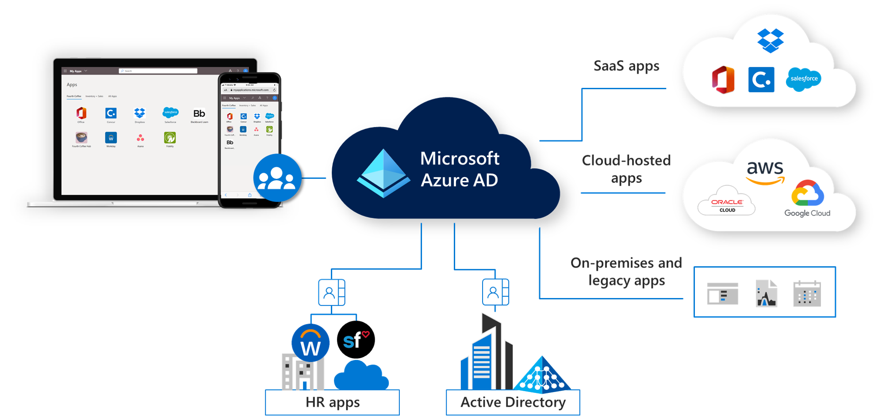

Slide 4
Azure AD Layers
WAAD - Windows Azure Active Directory
This layer combines all the problems related to identity management.
WAACS - Windows Azure Access Control Service
This layer enables the federation or the division of all these services of an organization.
Here division means assigning each of these services to the users.

Slide 5
Azure AD simplifies a lot of problems by using only by two layers.
For example, Office 365 uses Azure AD to manage user identities.
To make use of any of the Office 365 services like Excel, PowerPoint, or Microsoft Word, the administrator would only need to provide a single username and password.

Slide 6
Service Audience
There are three types of audiences in Azure active directory:
IT administrators
IT administrators take care of all the sign-in procedures. They also solve issues related to authentication.
Application developers
Application developers use these services to build applications. Development becomes quick since there are many resources available.

Slide 7
Online customers
They make use of services like Office 365, CRM services, and have all their demands catered immediately.
An identity and access management service that helps you access internal and external resources.

Slide 8
Azure AD licenses
Free – user and group management in your on-premises directory
Premium P1 – allows access to both on-premises and cloud resources.
Premium P2 – provides an additional feature called Azure AD Identity Protection.
Pay as you go – offers a feature called Azure AD B2C.

Slide 9
Features
You can use Azure AD Authentication for a self-service password reset, MFA, custom banned password list, and smart lockout.
Allows you to manage external identities using Azure AD B2B.
Azure AD B2C is a business-to-customer identity as a service that allows you to control how your users sign up, sign in, and manage their profiles when using your applications.
Azure AD B2C provides you control on how your users sign up, sign in, and manage their profiles when using your applications.
You can manage the access in your cloud apps with conditional access.

Slide 10
With Azure AD Device Management, it allows you to manage and configure device identities.
If you need to manage domain services such as domain join, group policy, and authentication, you can use Azure AD Domain Services.
Identity Governance ensures that only the authorized people have the right access to specific resources.
Supports hybrid identity to access resources in the cloud or on-premises.

Slide 11
Use Azure AD Connect to accomplish your hybrid identity goals:
A sign-in method that uses password hash synchronization.
Pass-through authentication allows users to use the same password on-premises and in the cloud.
Enable federation integration to sign in to Azure AD-based services without having to enter their passwords again.
Synchronization between your on-premises environment and Azure AD.
Health Monitoring with Azure AD Connect Health.

Slide 12
Concepts
Users :
You can create a new user in your organization or a guest user.
By enabling Multi-Factor Authentication, you provide additional security by requiring the user a second form of authentication.
The additional forms that can be used with Azure AD MFA are:
Microsoft Authenticator app
OATH hardware token
SMS
Voice call

Slide 13
You can also perform the following bulk operations:
Bulk create
Bulk invite
Bulk delete
Bulk restore
Download users
Self-service password reset enables users to manage their passwords from any device, at any time, and from any location.
In the device settings, you can change the maximum number of devices per user.
You can assign licenses to multiple users or groups to allow them to use the licensed Azure AD services.
Licenses are applied per tenant, and you can’t transfer them to other tenants.

Slide 14
Monitoring
Monitor the security and usage patterns of your environment with Azure AD reports and monitoring.
With Azure AD Connect Health, you can view alerts, monitor performance and check usage analytics of your on-premises Active Directory and Azure AD.

Slide 15
If you register your application to use Azure AD, the users in your organization can do the following:
Get an identity for their application that is recognized by Azure AD.
Get secrets/keys that the application will use for authentication.
Create a custom name and logo for your application.
Apply Azure AD authorization (RBAC and oAuth)
Declare the necessary permissions for the application.
With application proxy, you can provide SSO and remote access for web apps hosted on-premises.

